Slide 1
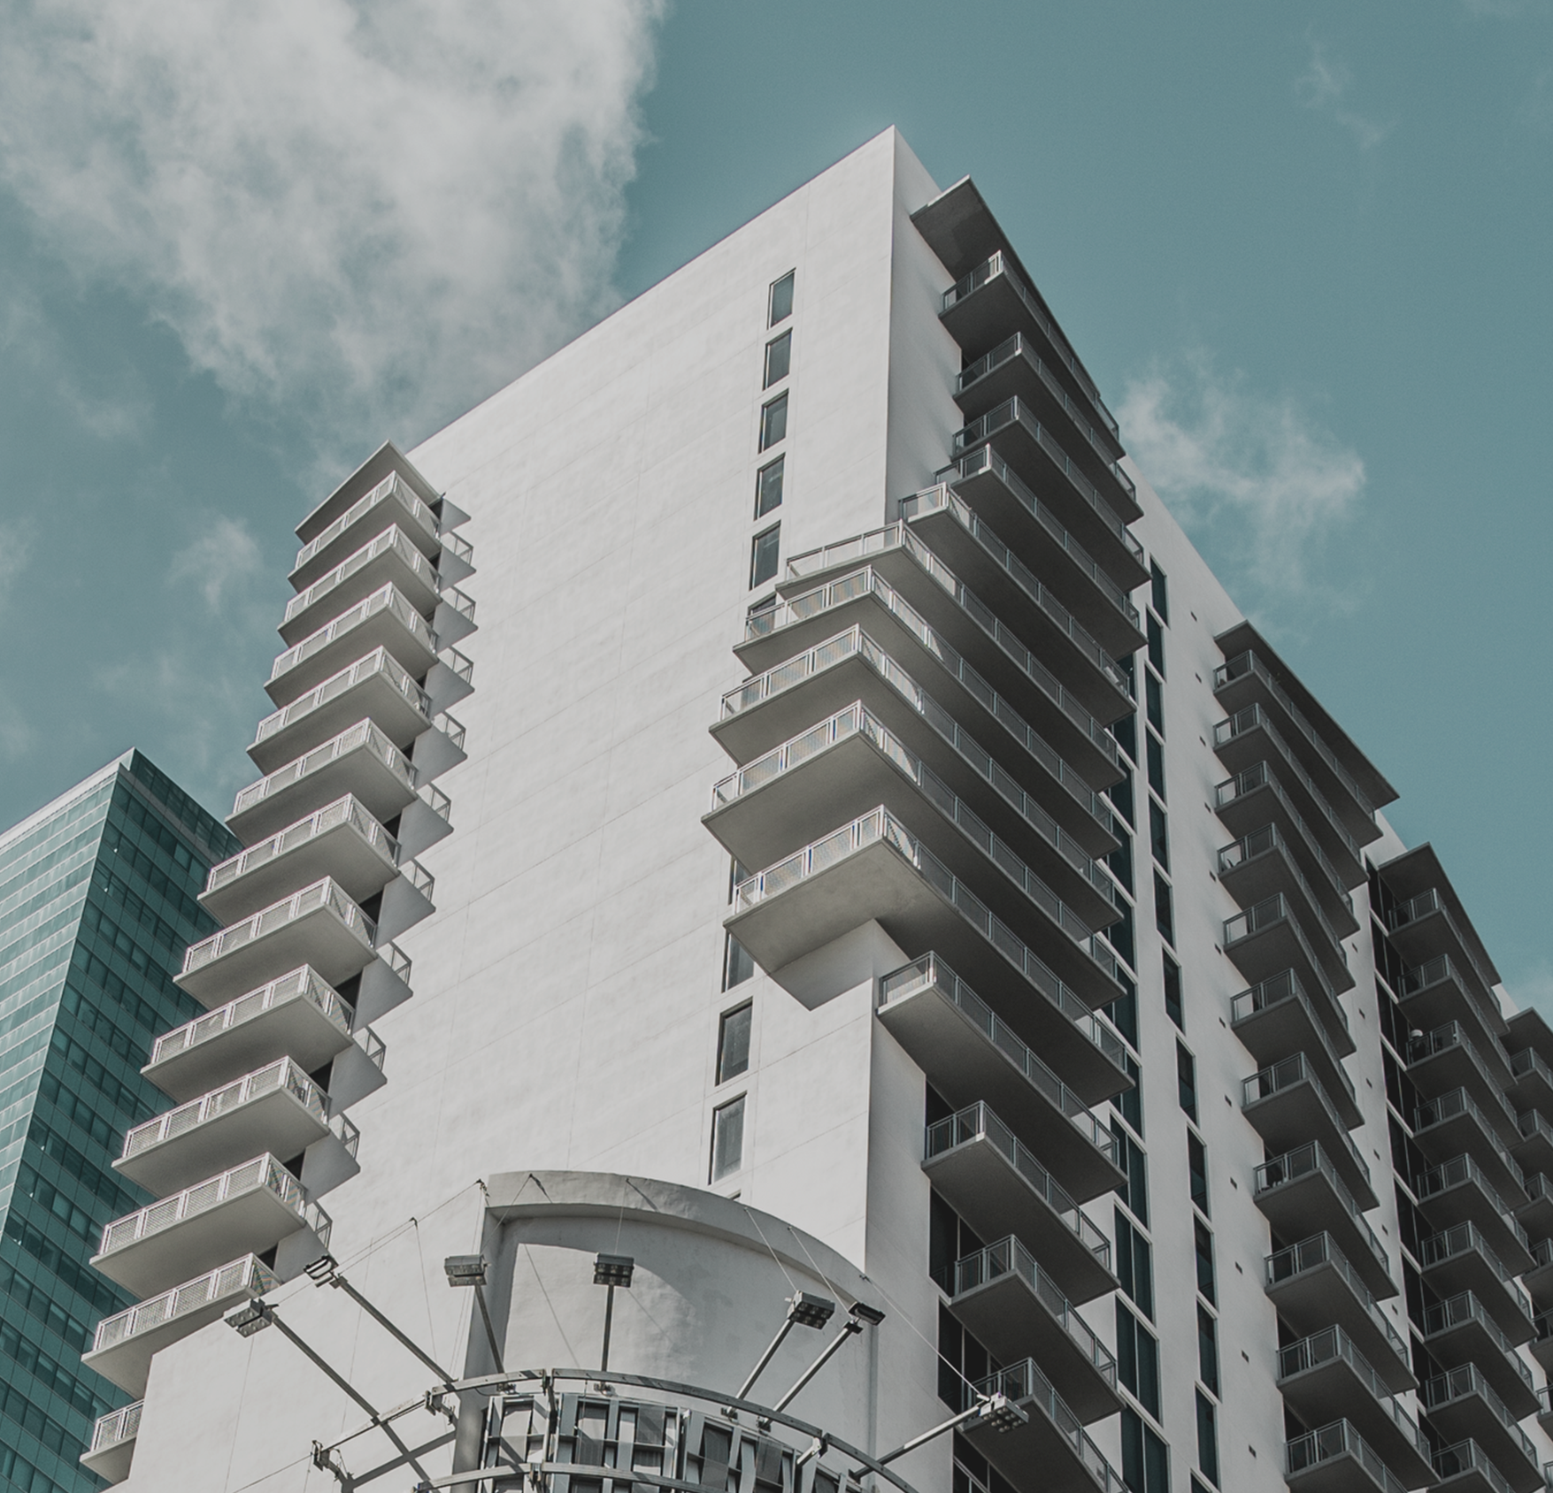

Slide 2
ABOUT US
GMD-Tech is a full-service construction business offering general contracting services. We are embedded in providing excellent client service, quality output, and fair competitive pricing of labor and supplies. Awarded projects are unremittingly accomplished in a reasonable time frame because of our defined jobs and their functions, time management skills and proper communication techniques.
OUR MISSION
We hire and cultivate works with great perspective in life that can help the company commit and yield successful projects.
OUR VISION
To build long standing infrastructures and solve technical problems. To mold workers with good morals and values, creative ideas that can contribute expansion

Slide 3
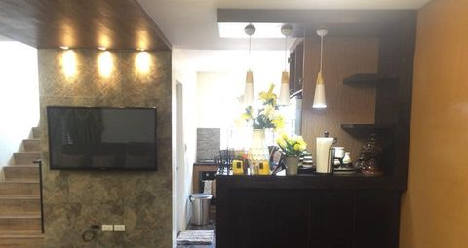
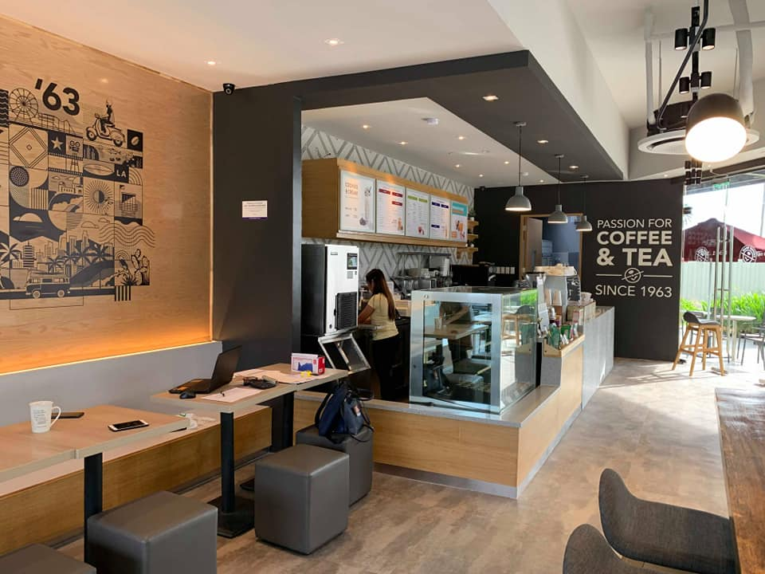
SERVICES OFFERED:
*DESIGN *CONSTRUCTION *RENOVATION
CIVIL &
ARCHITECTURAL WORKS, ELECTRICAL WORKS, MECHANICAL WORKS,
PLUMBING/SANITARY WORKS, REPAIR & MAINTENANCE

Slide 4
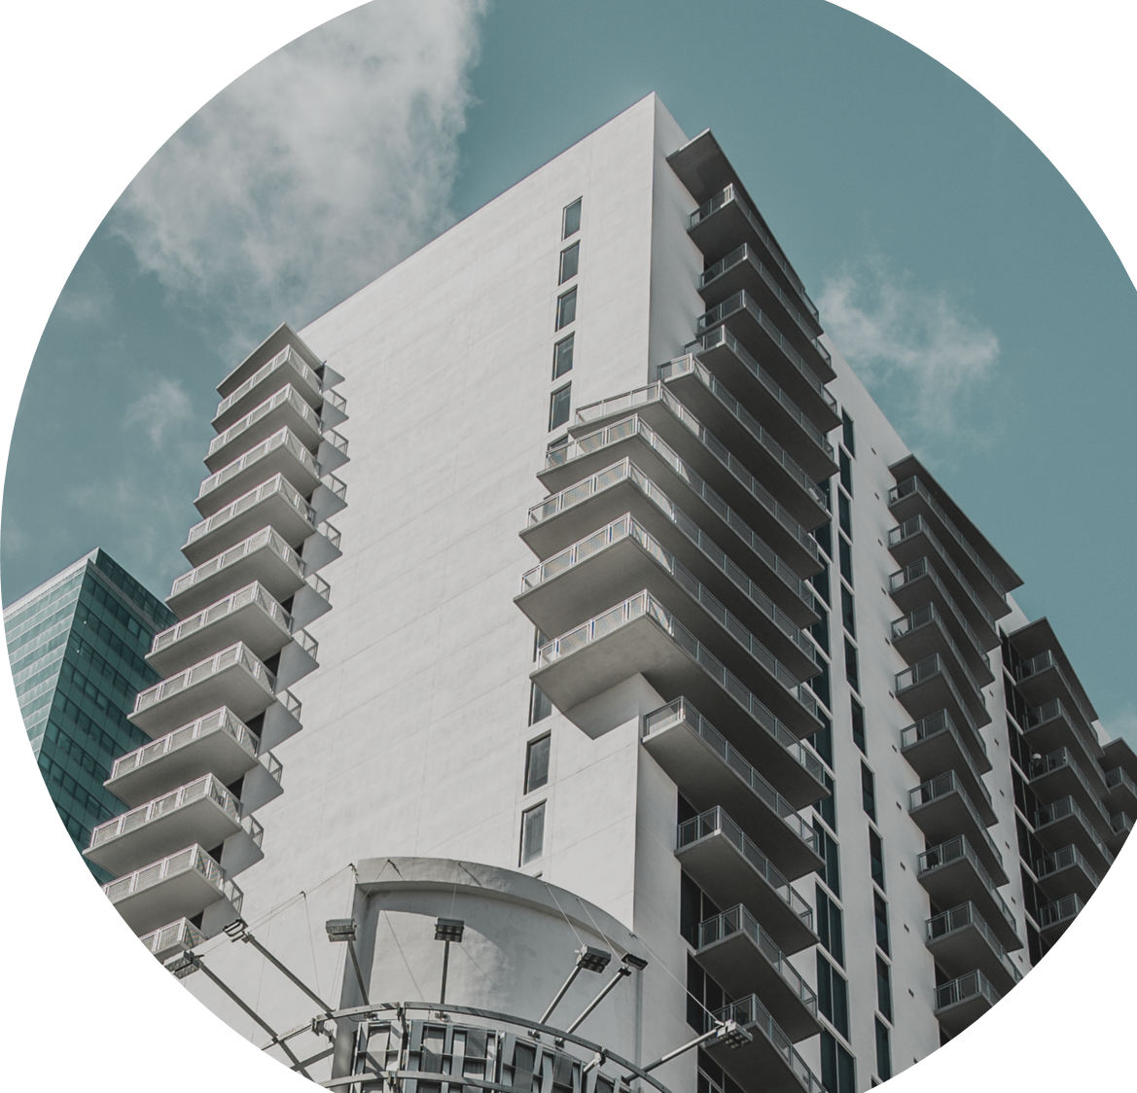

Slide 5
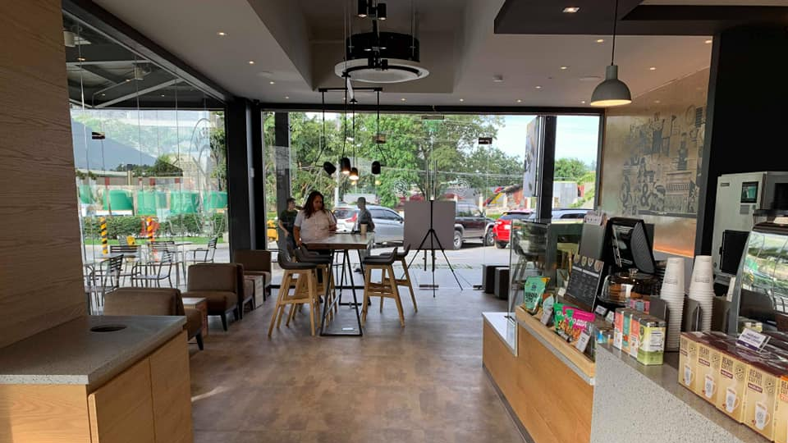
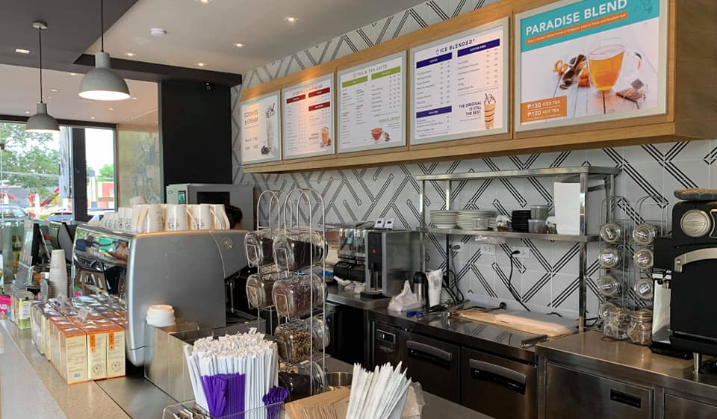
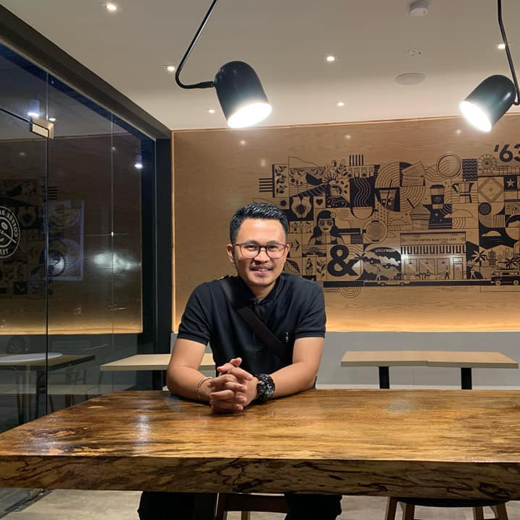
COFFEE BEAN, ASUELA COVE DAVAO

Slide 6
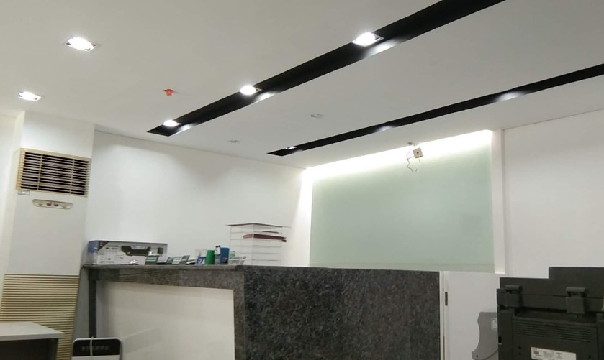
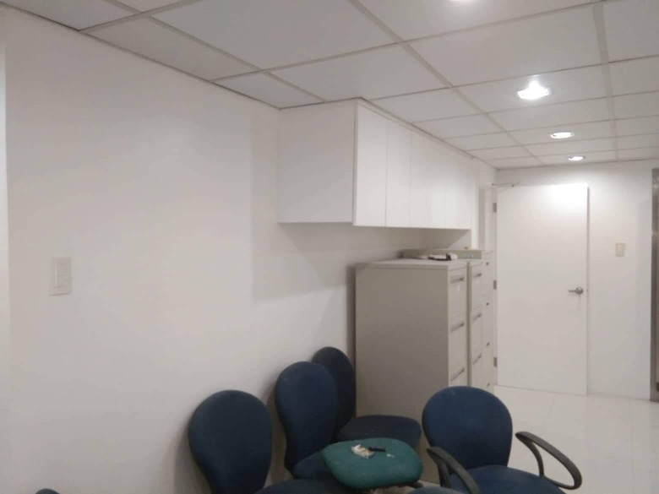
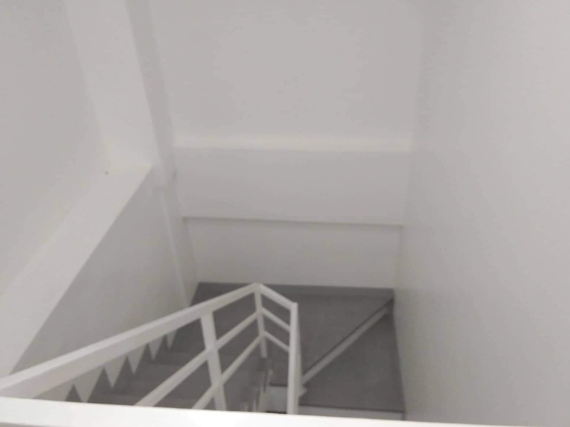
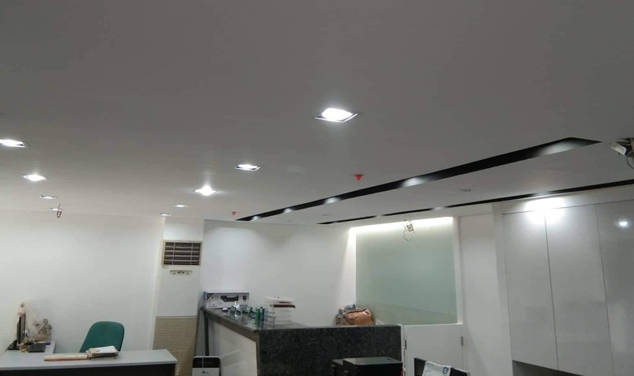
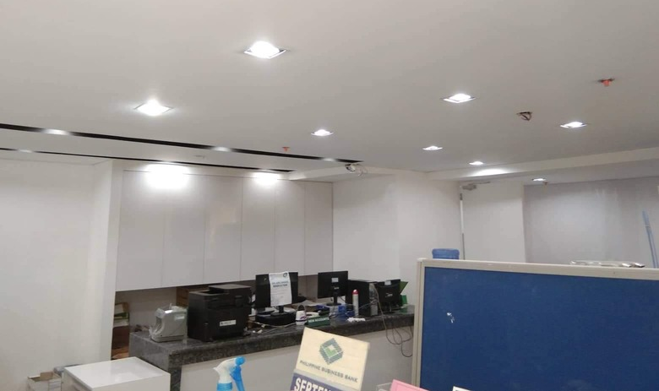
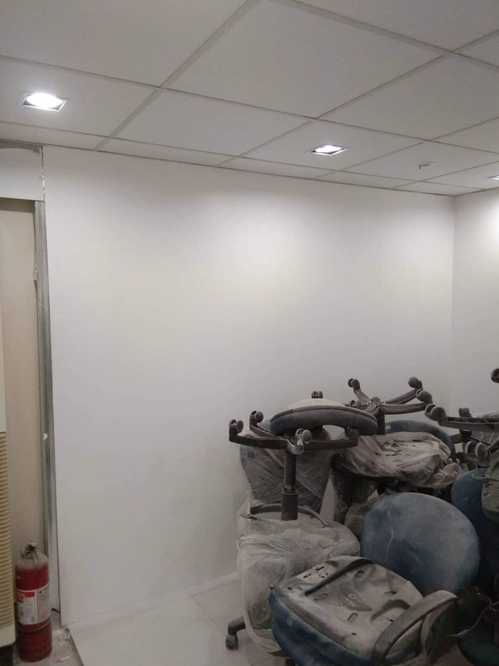
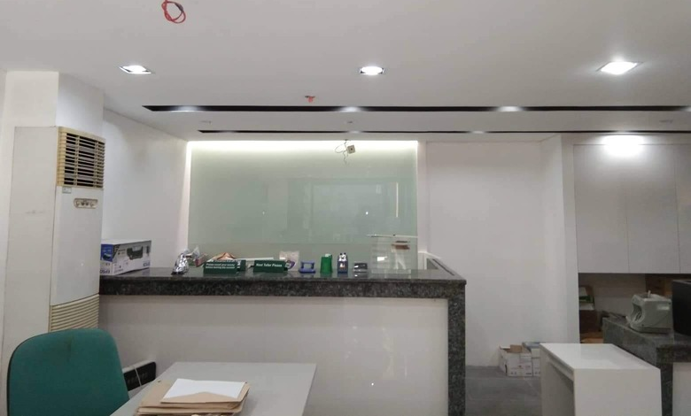
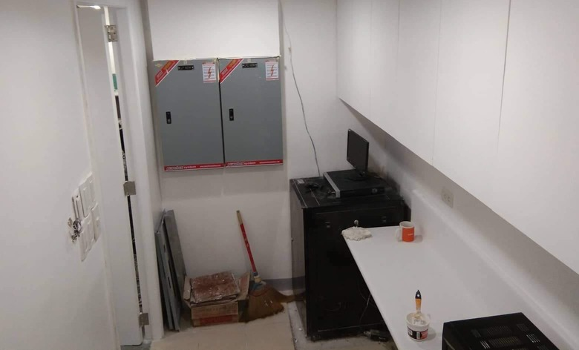
PBB The Fort, BGC
Interior Renovation, Labor Works, Subcon Architectural and Electrical Works

Slide 7
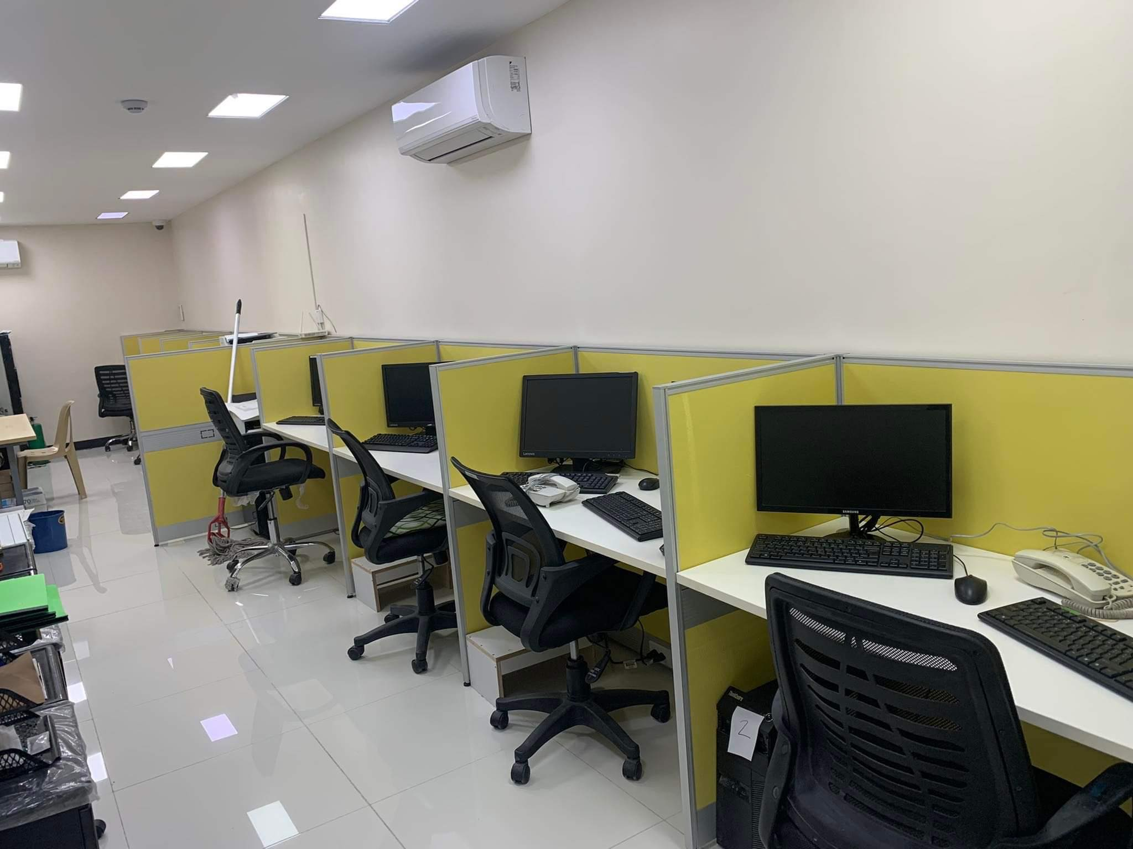
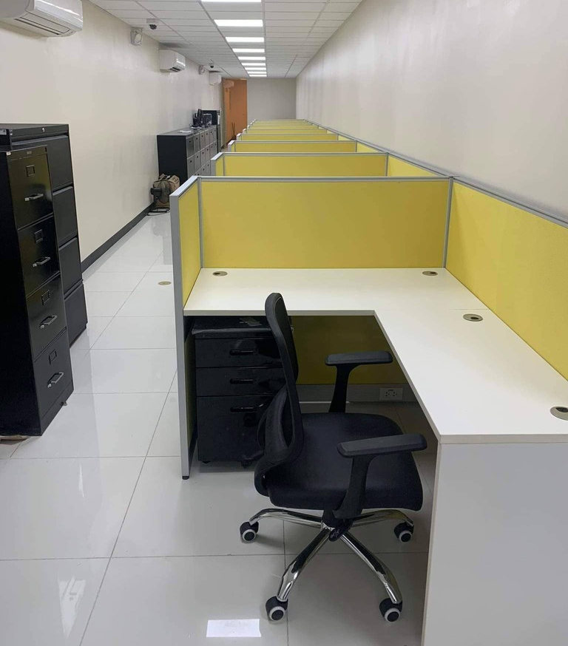
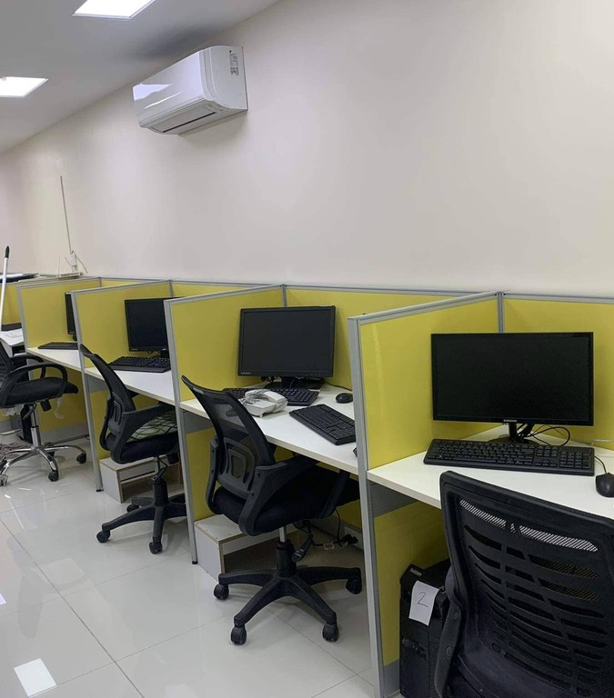
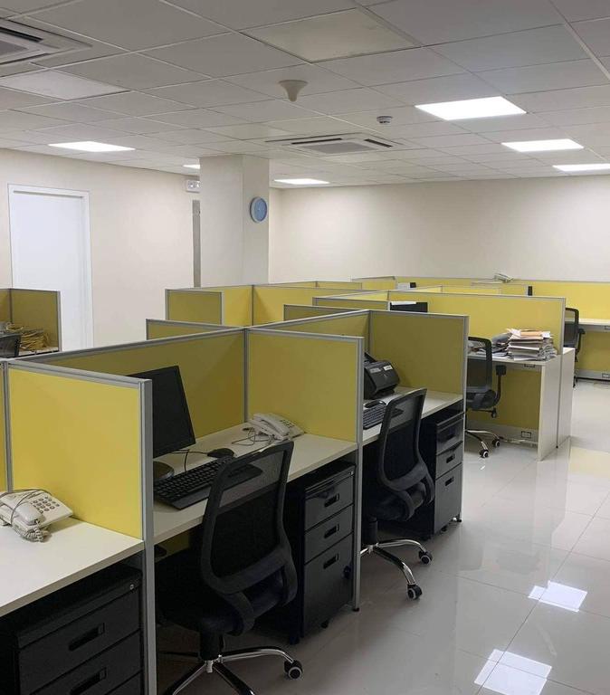
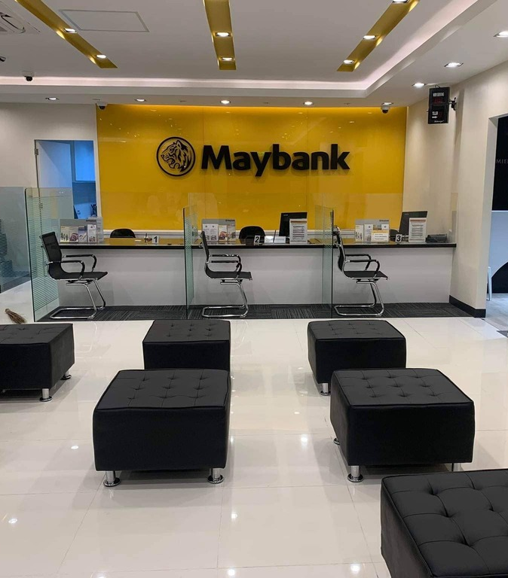
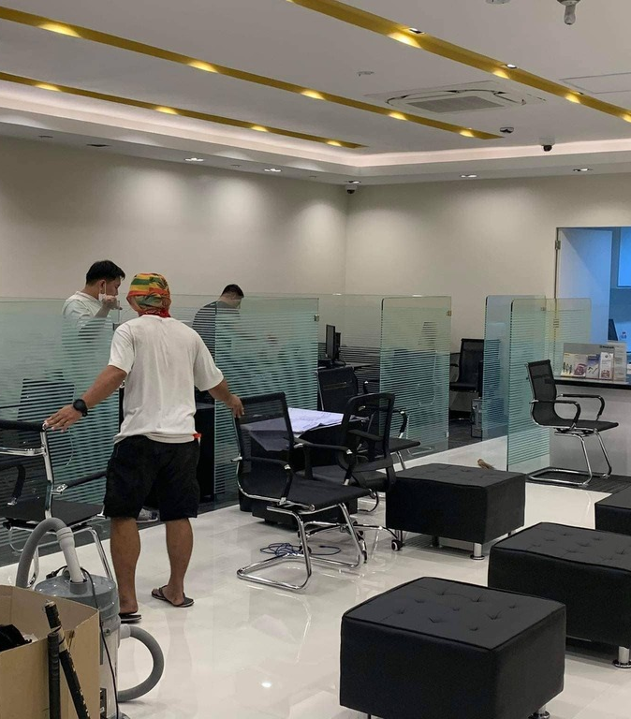
Maybank, San Fernando, Pampanga
Under P2 Construk, Labor works

Slide 8
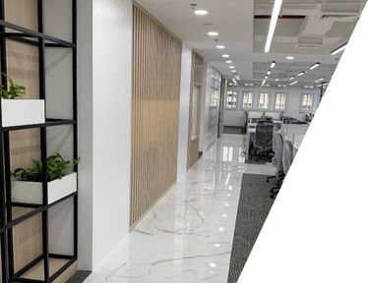
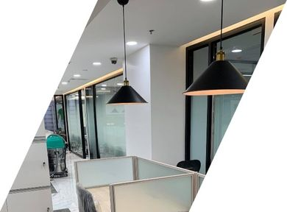
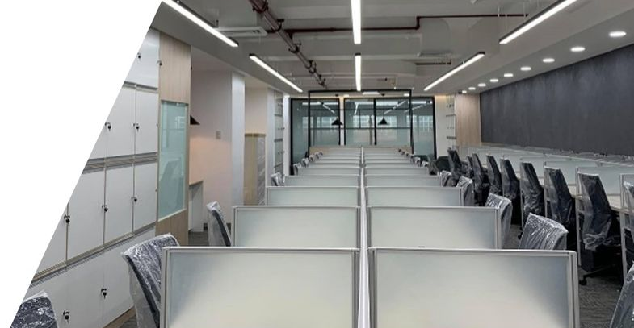
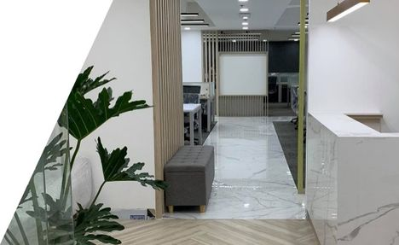
5F SGV-1 BLDG. MAKATI FIT OUT CONSTRUCTION
IN PARTNERSHIP WITH
MATMALLILLIN ENG’NG DESIGN & CONST.

Slide 9
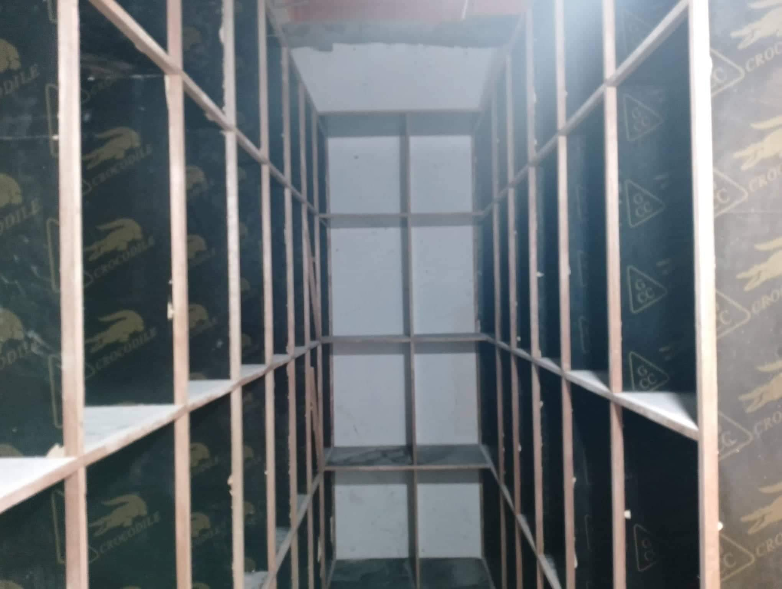
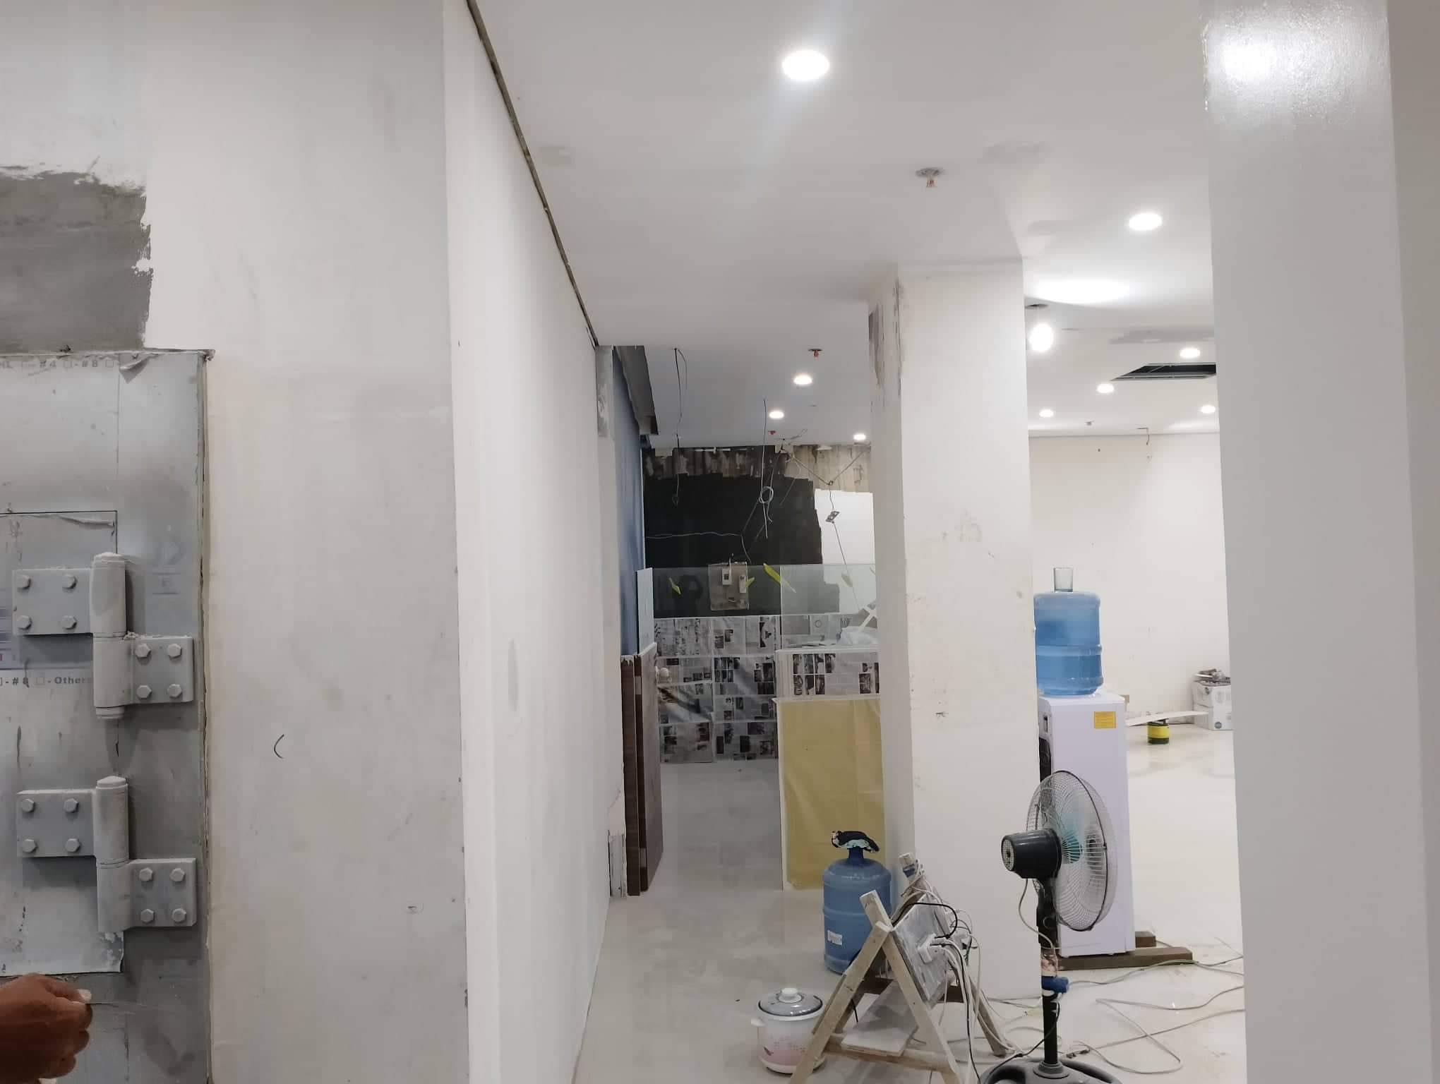
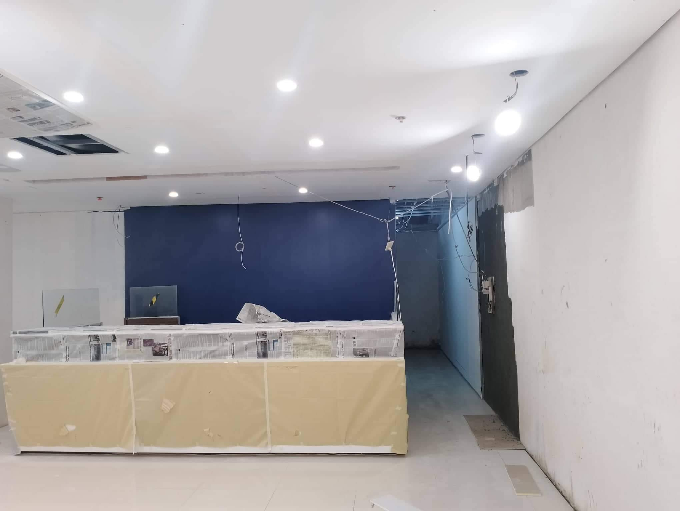
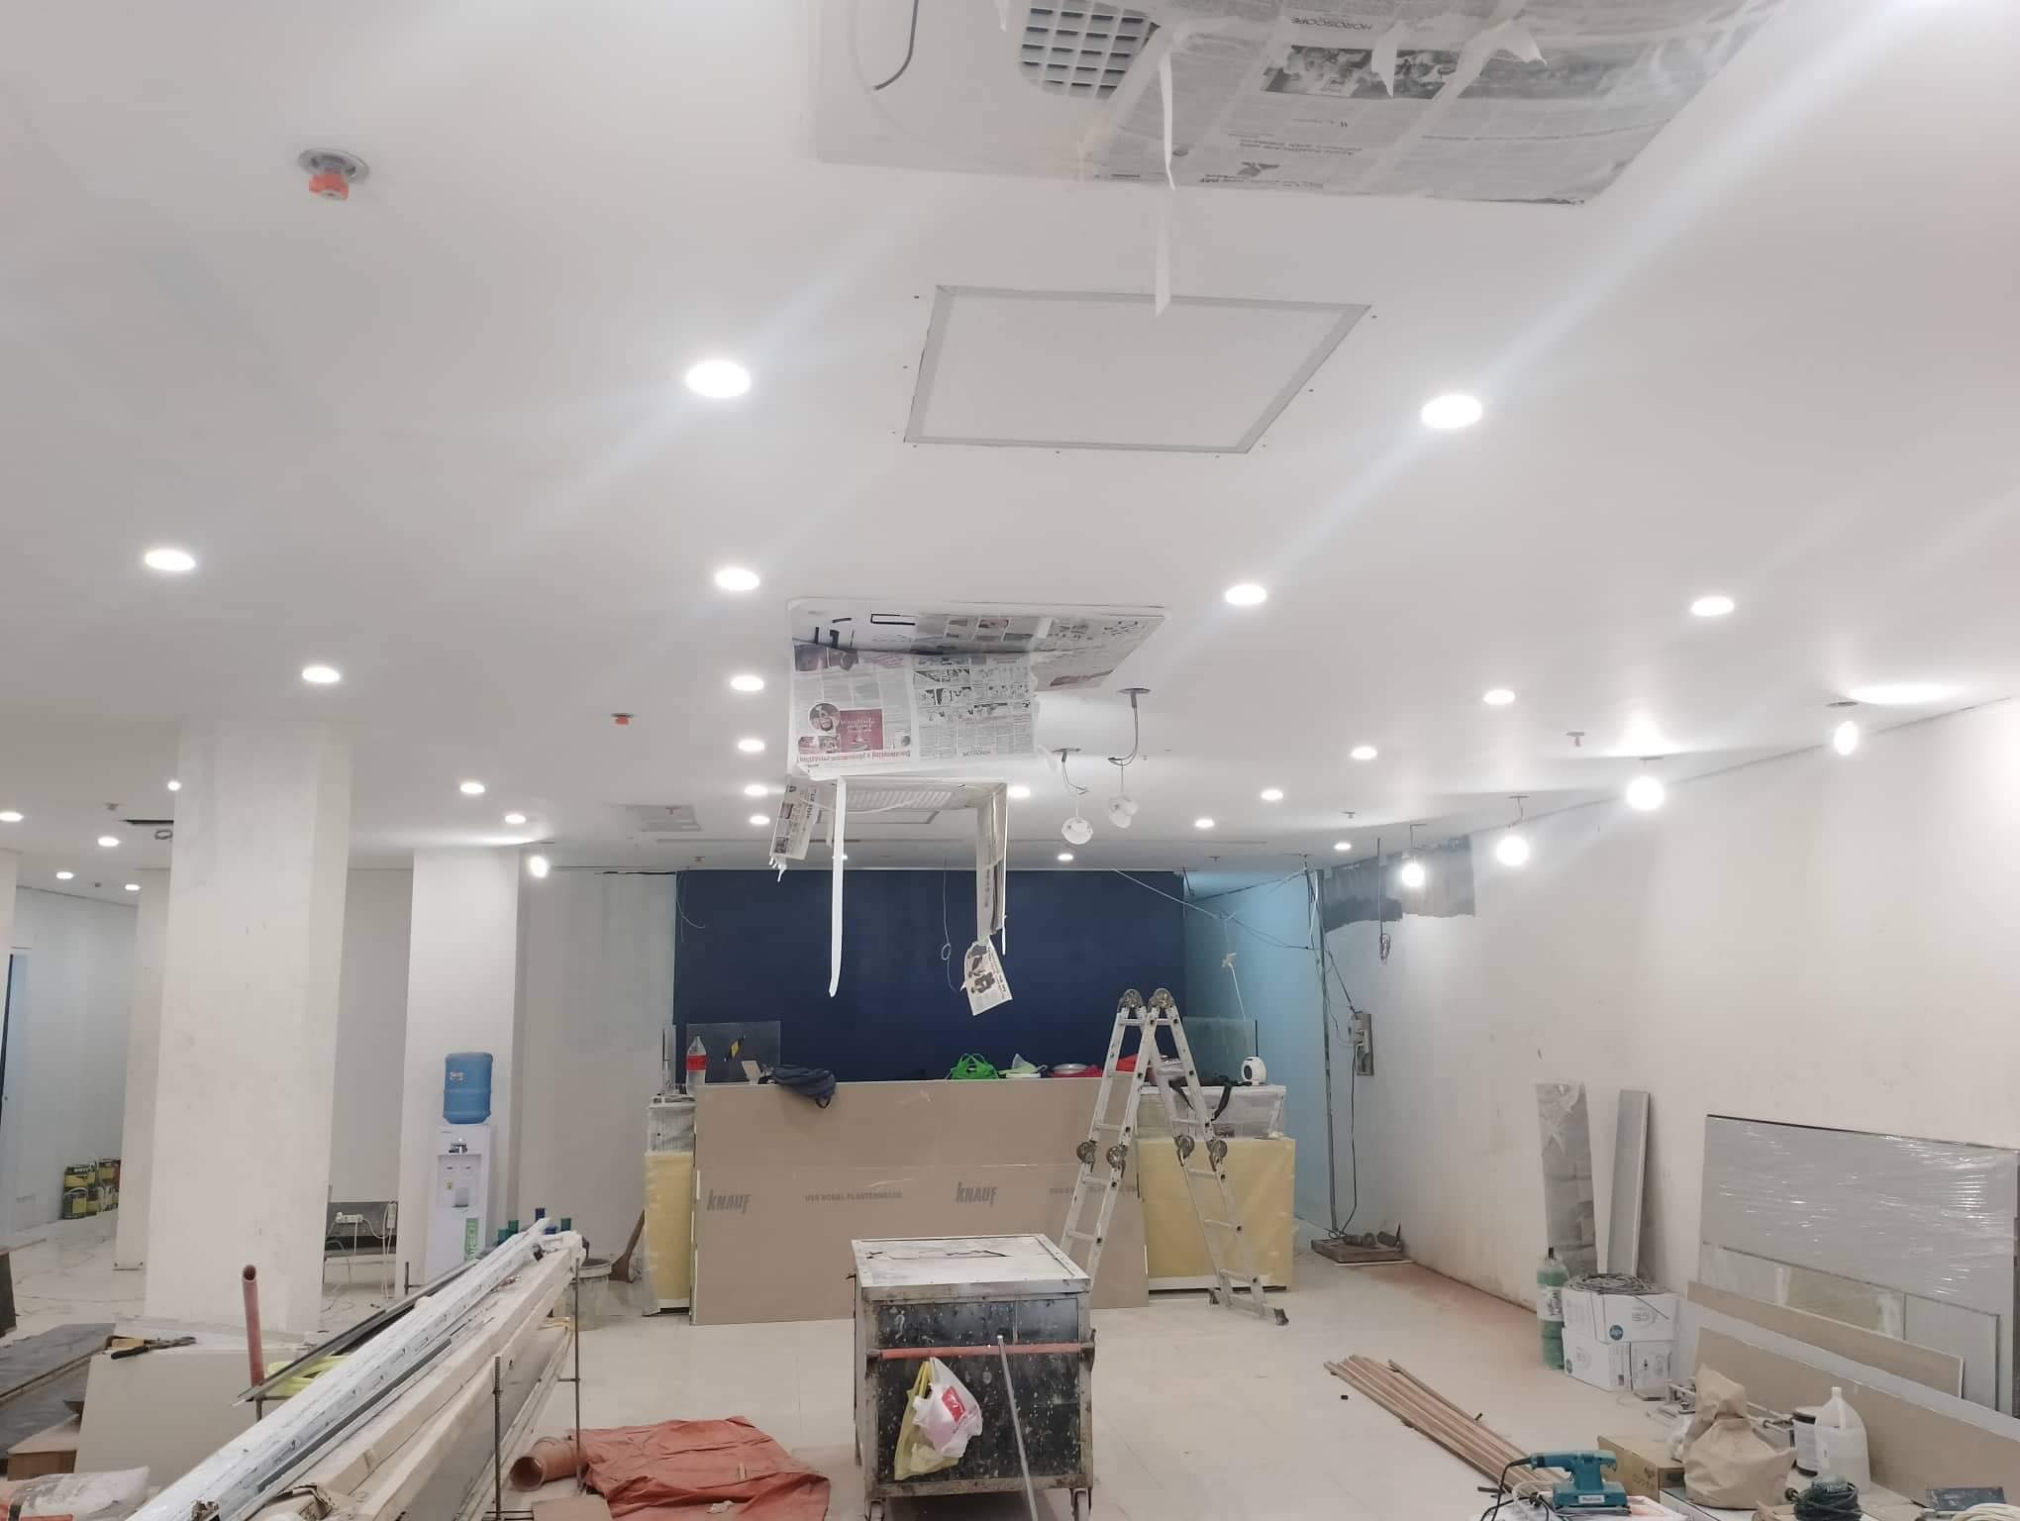
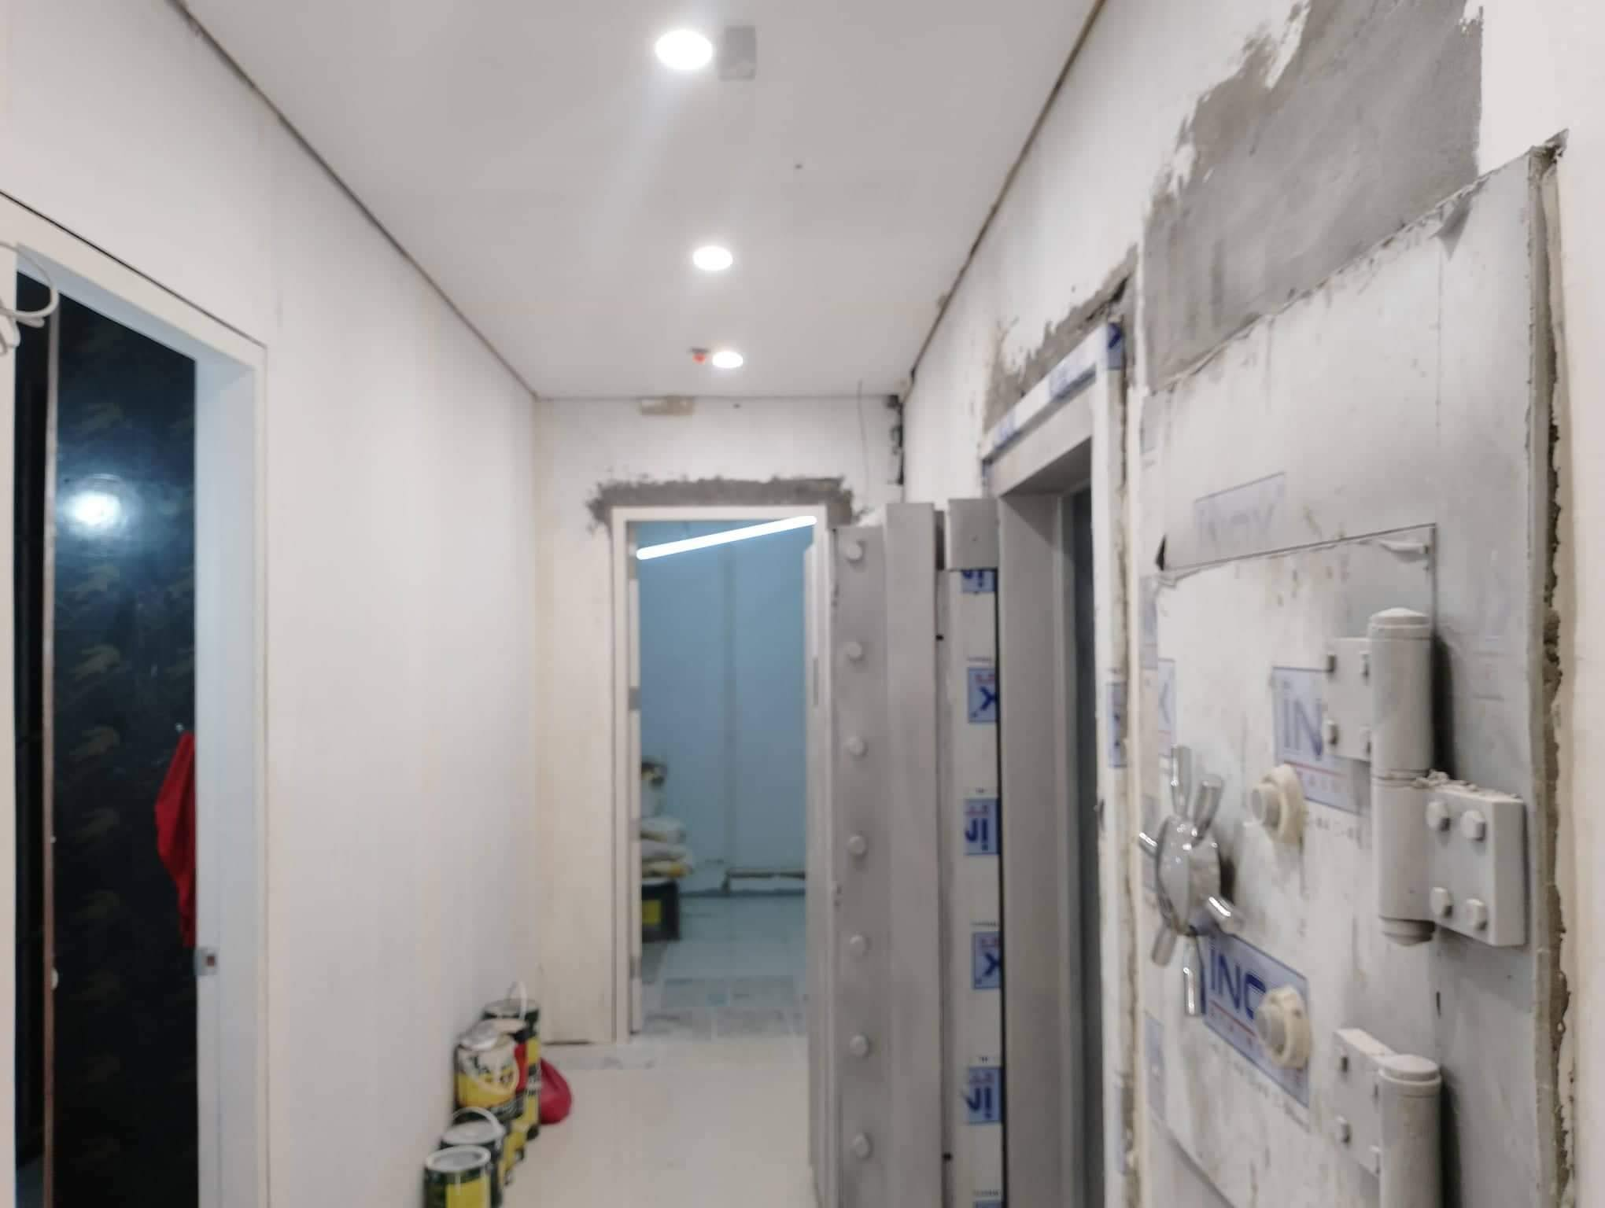
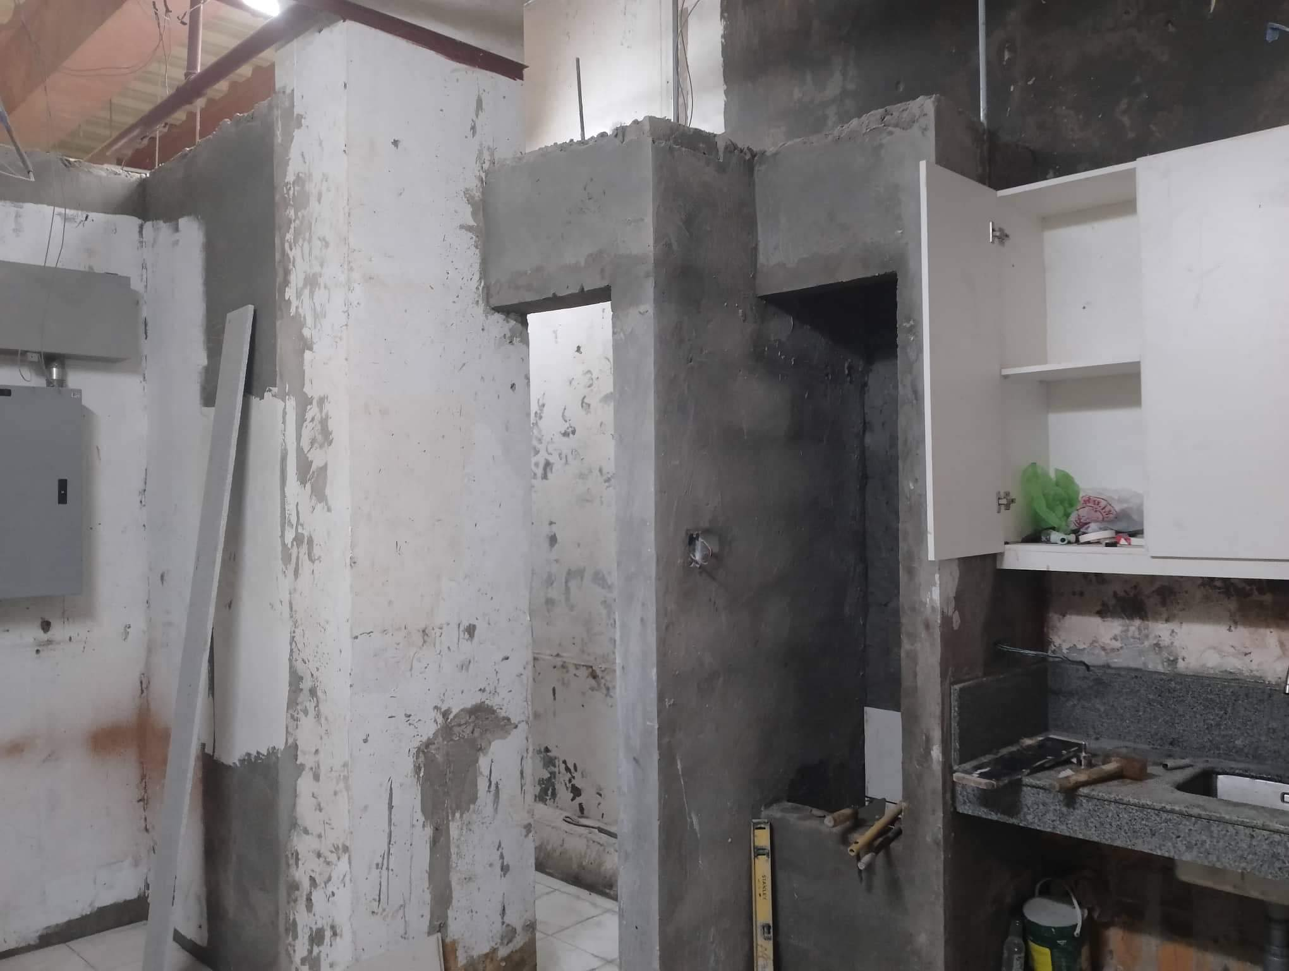
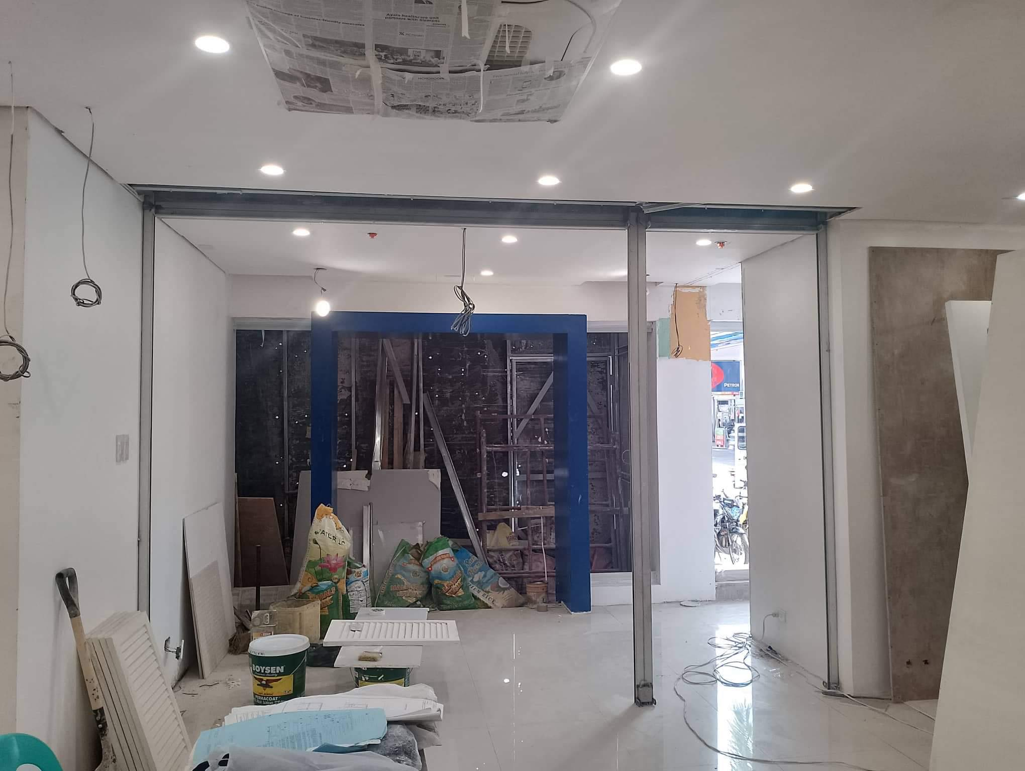
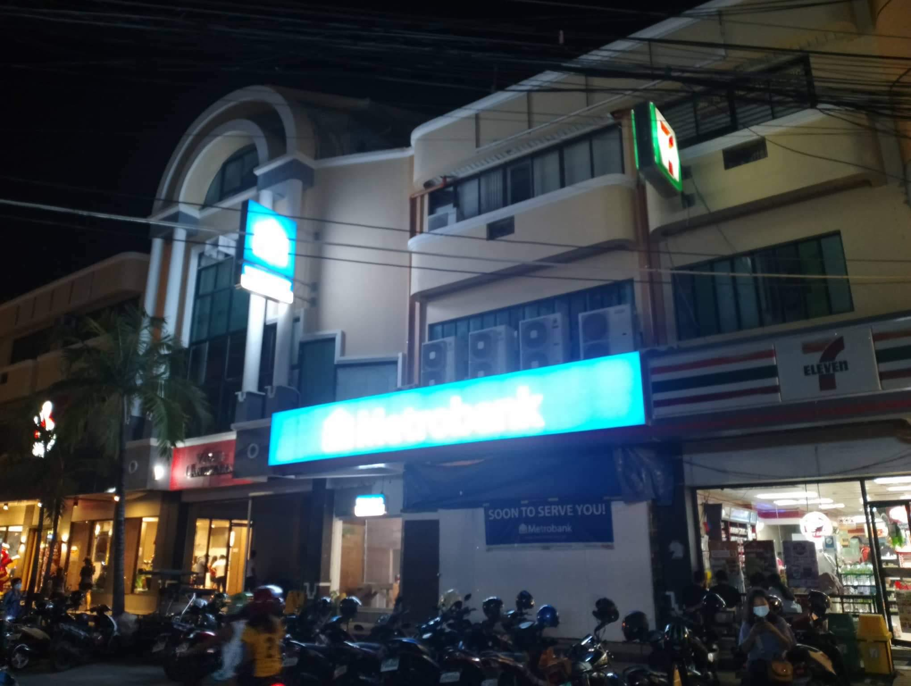
Ongoing Construction of Metrobank
Vigan
Subcon Under LPS
Civil & Architectural works, Electrical, plumbing and sanitary works

Slide 10
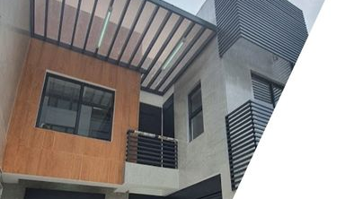
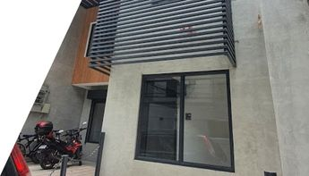
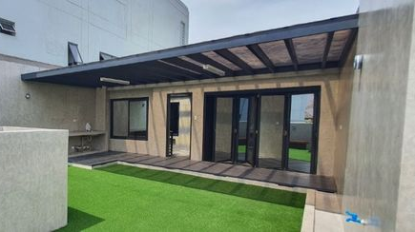
KYBIE BLDG, CUBAO
IN PARTNERSHIP WITH MATMALLILLIN

Slide 11
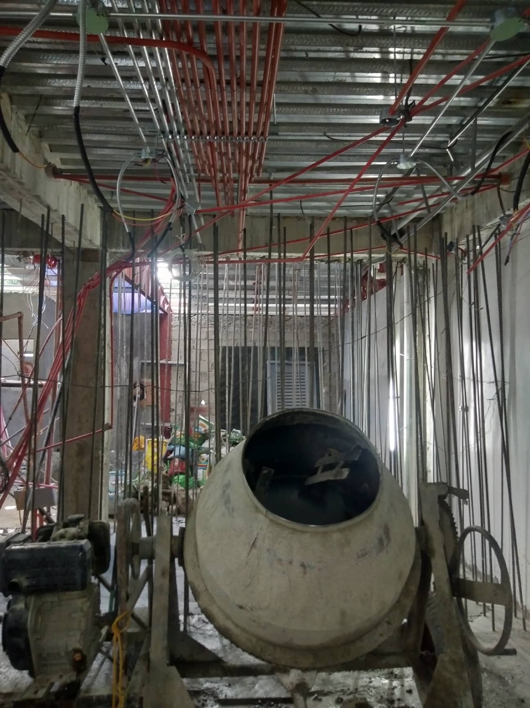
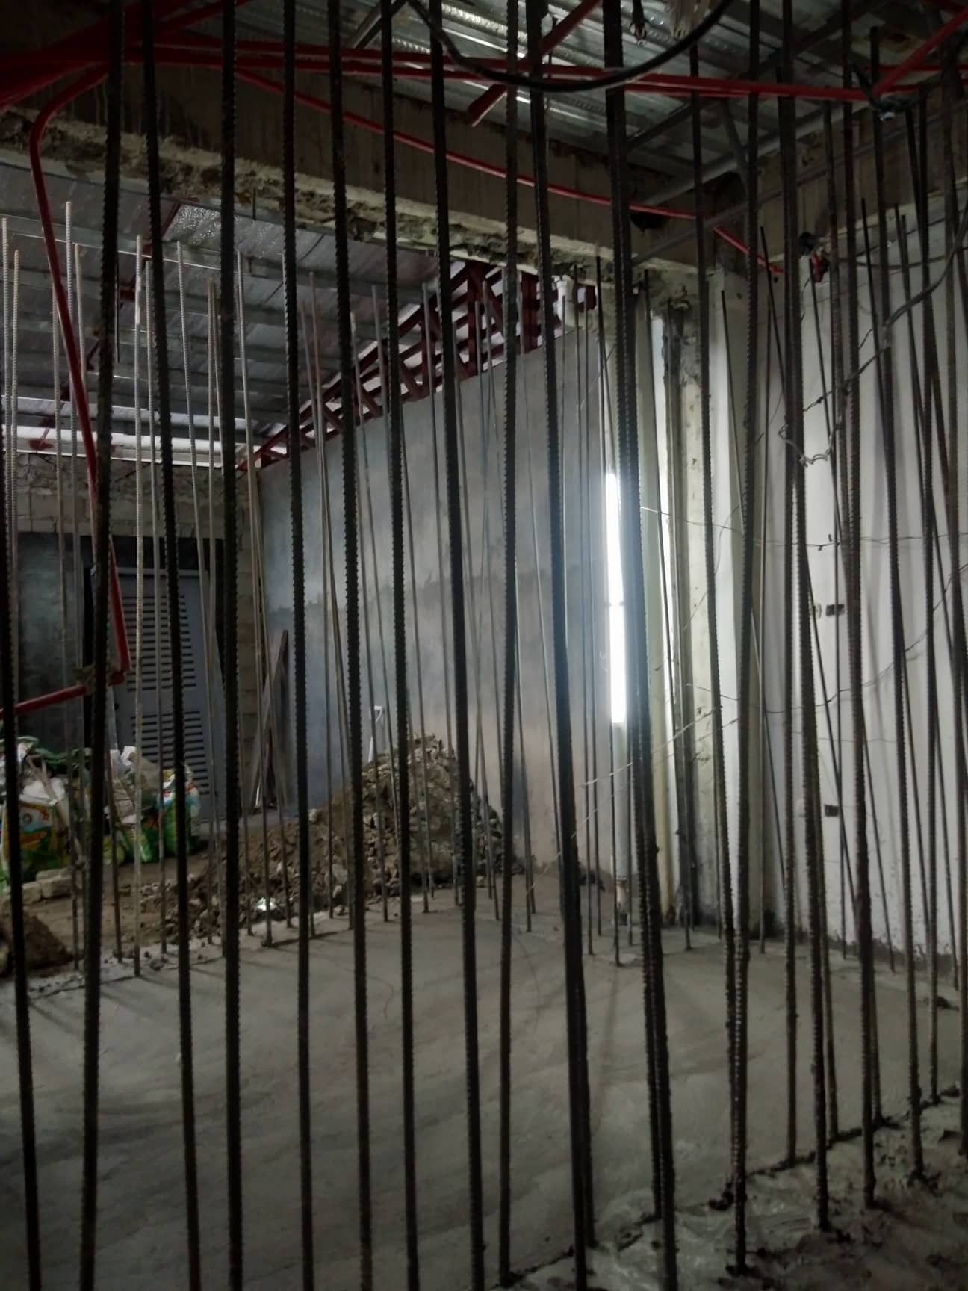
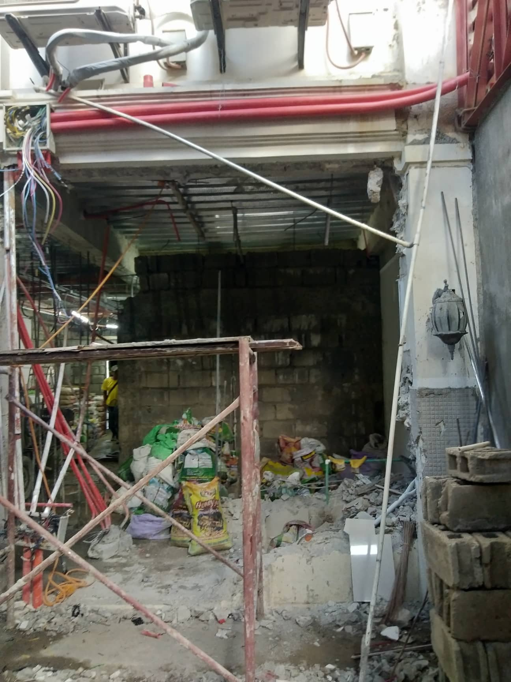
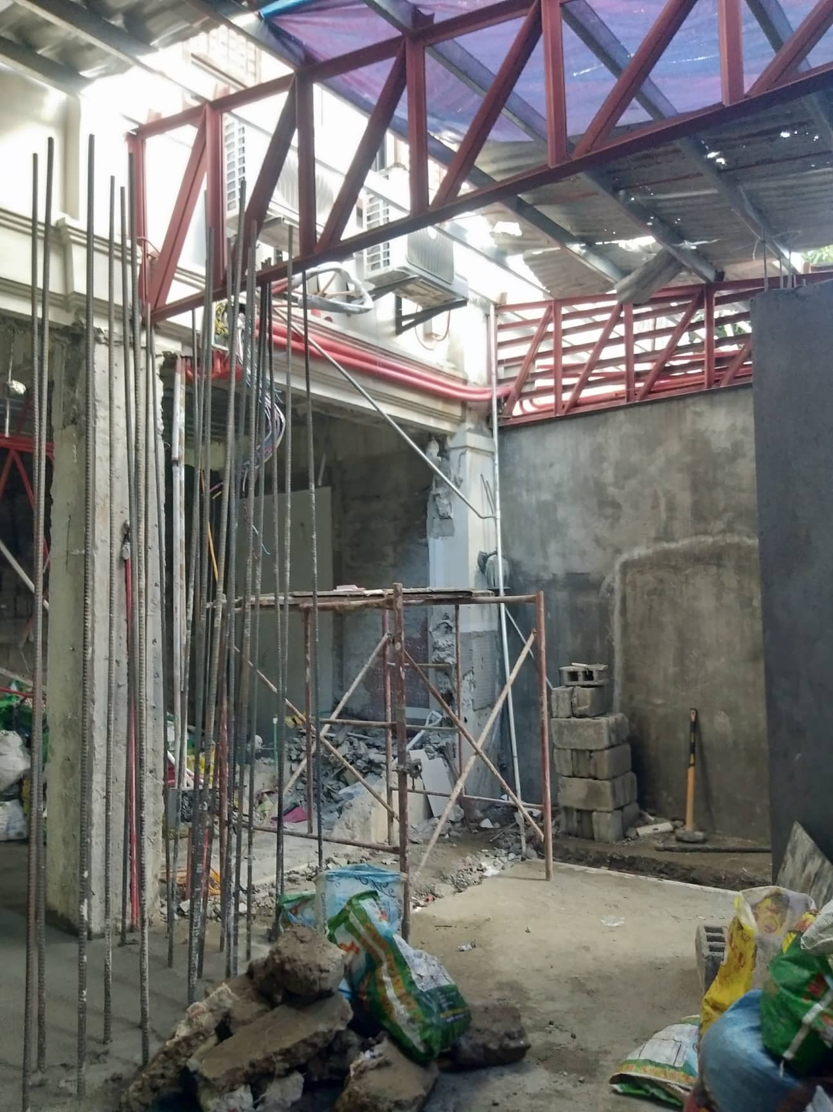
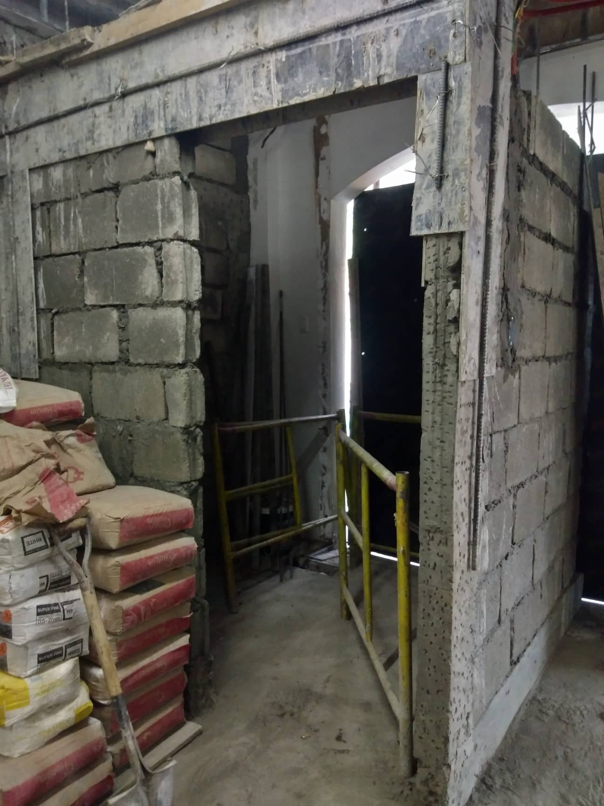
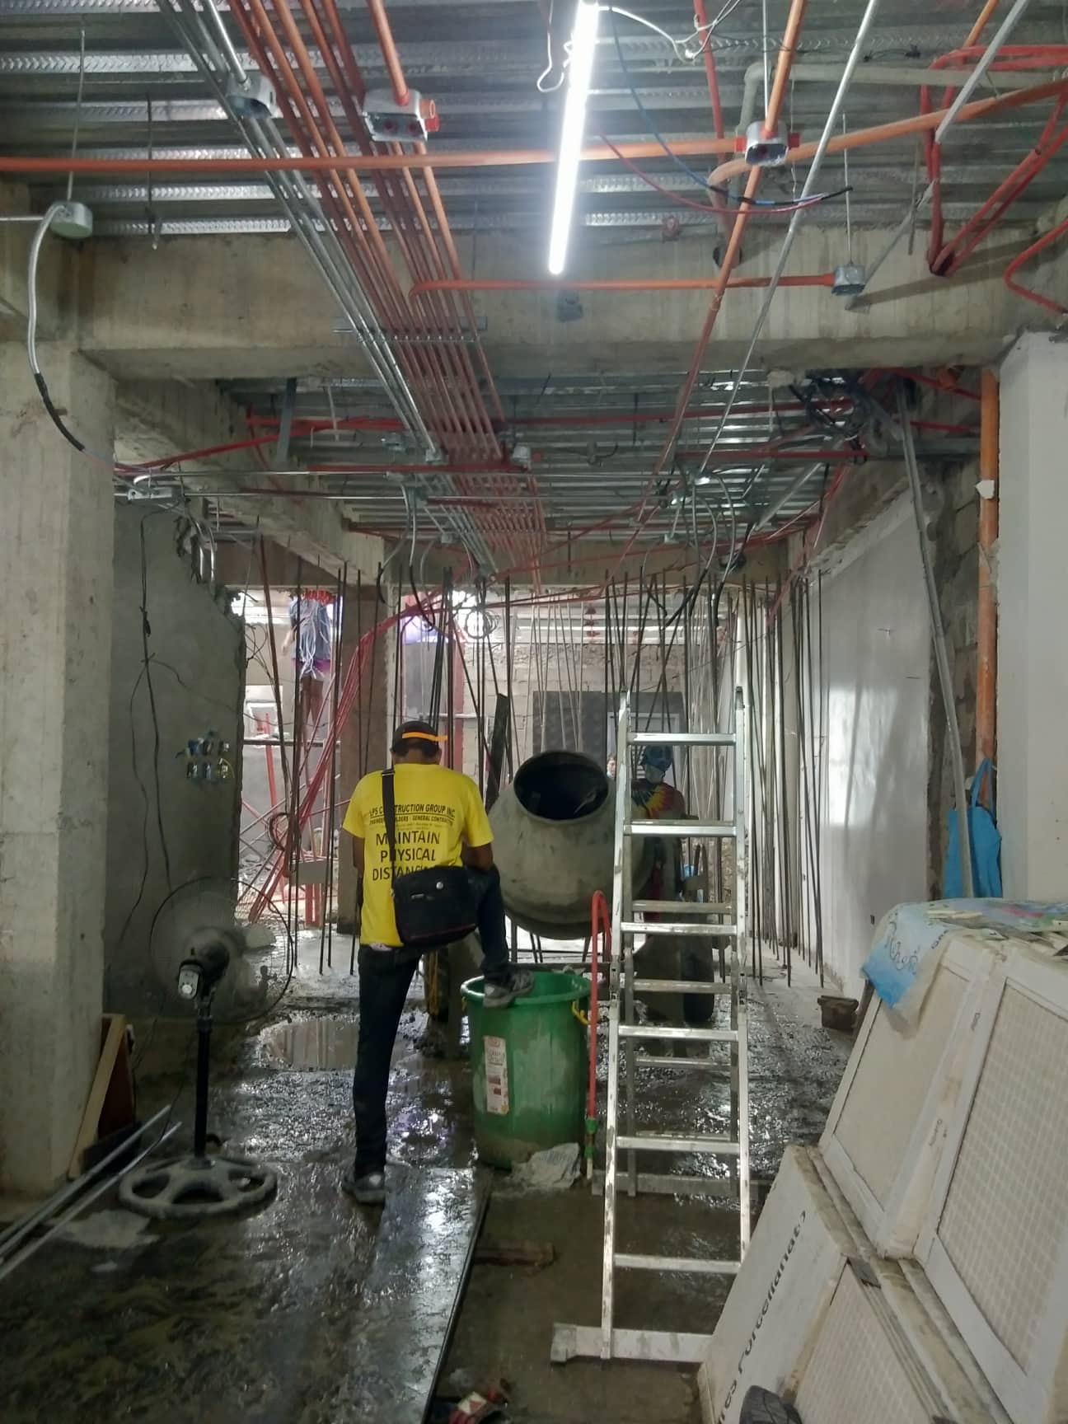
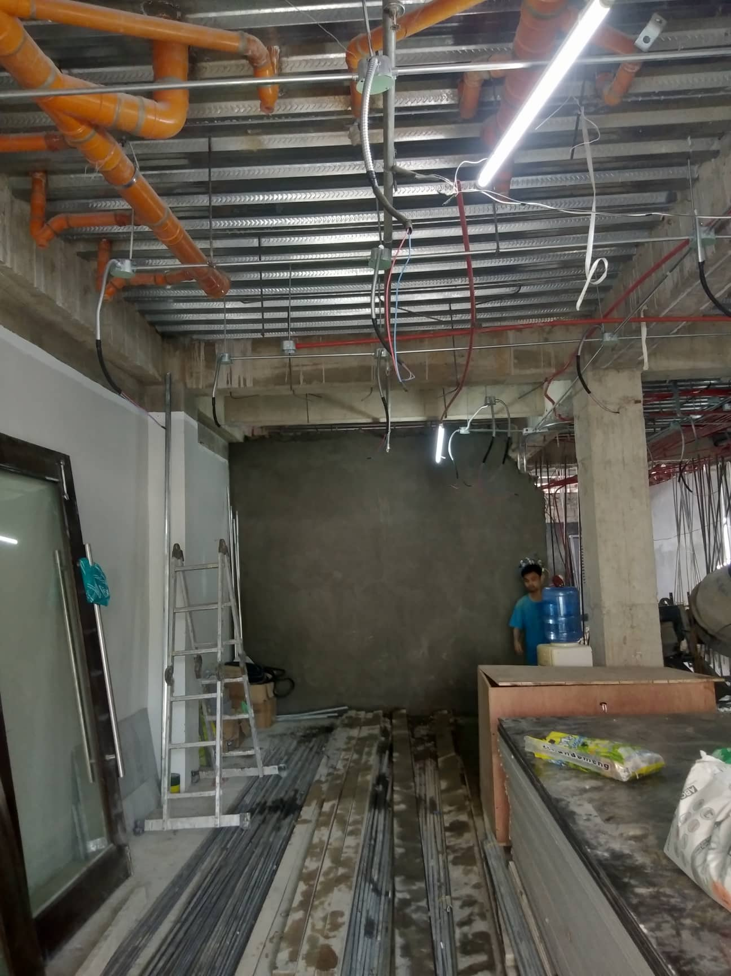
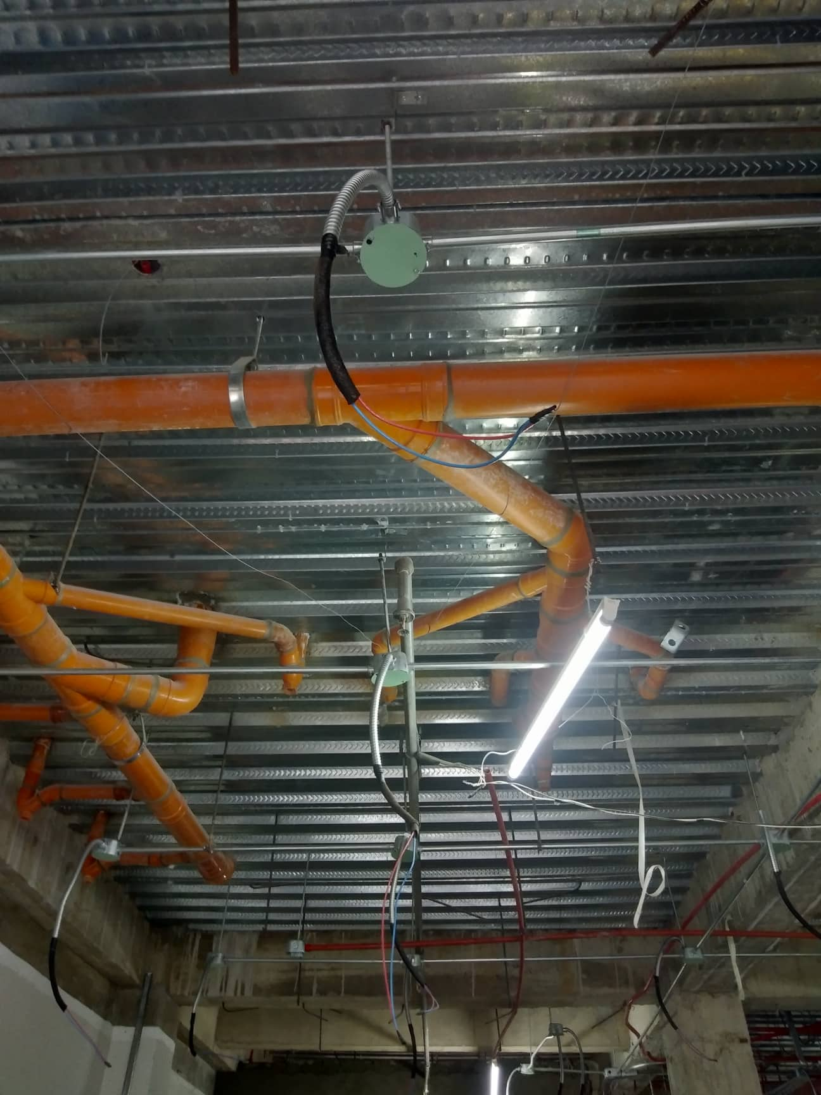
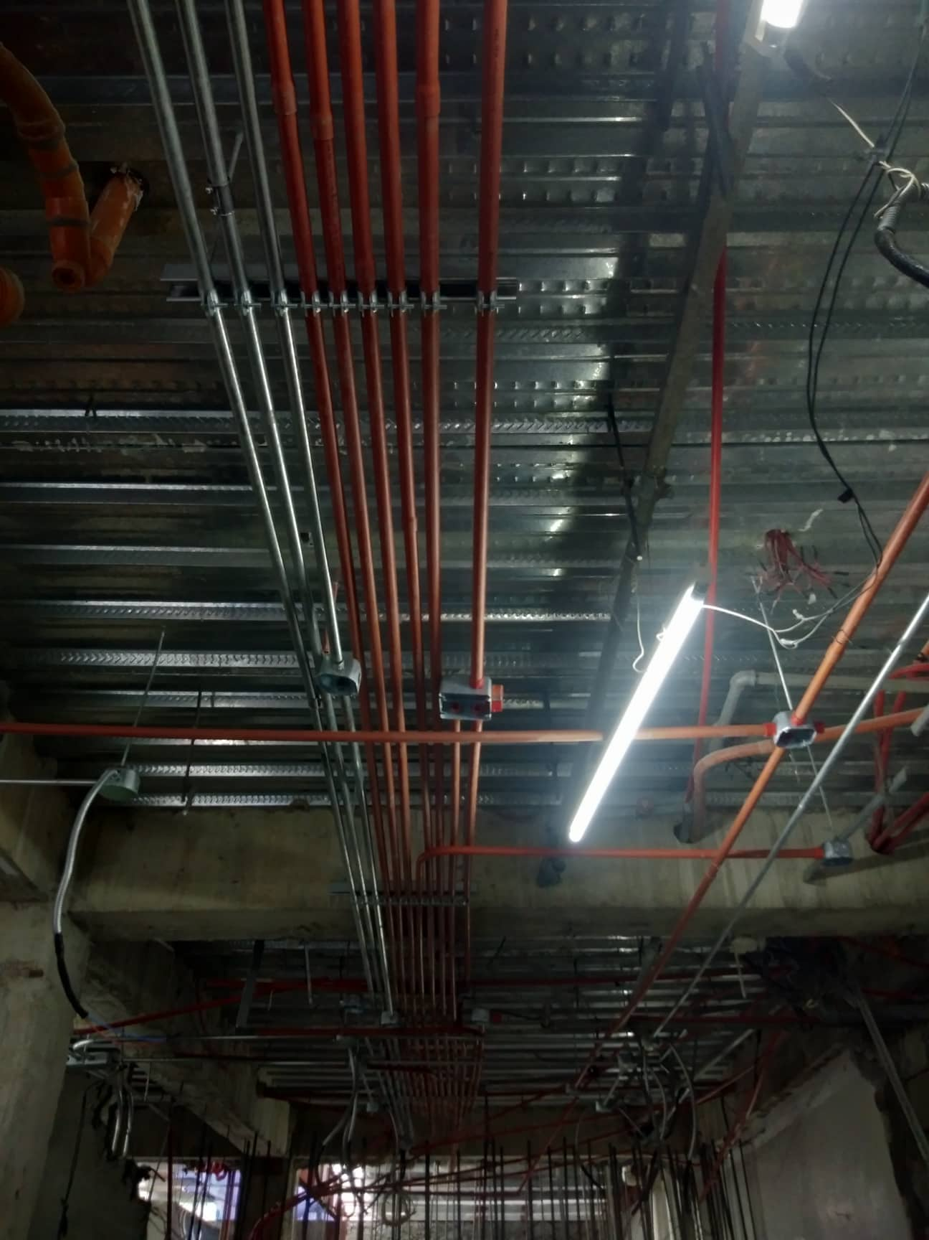
Ongoing
Construction of PS Bank Vigan
Subcon Under LPS Construction
Civil & Architectural works, Electrical, plumbing and sanitary works

Slide 12
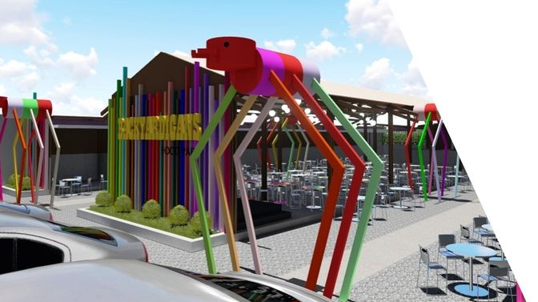
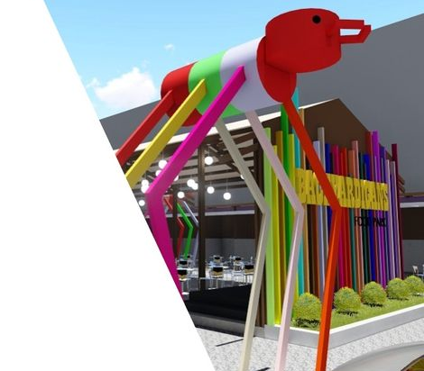
Backyardigans Food Park
Caloocan

Slide 13
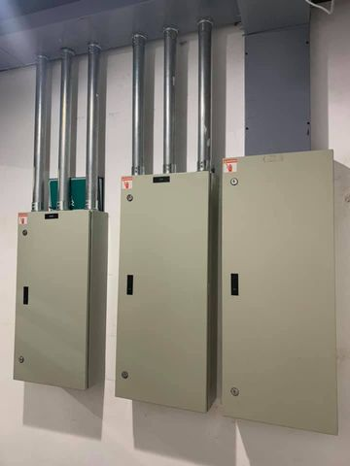
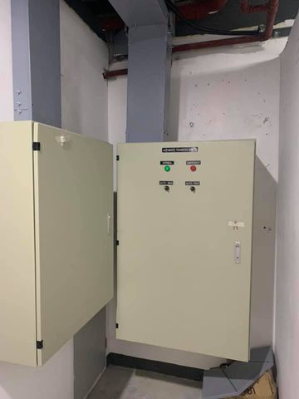
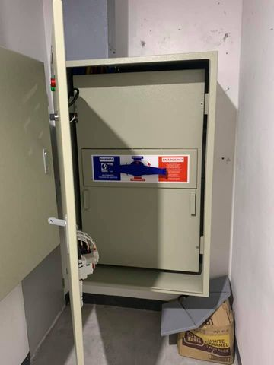
COLLECTIVE SOLUTION OFFICE
ELECTRICAL WORKS

Slide 14
METRO DENTAL CLINIC, FESTIVE MALL, ILOILO IN PARTNERSHIP WITH ARRIANSTAR ENTERPRISES

Slide 15
PHILAM LIFE CUBAO, AUTOMATIC VOLTAGE REGULATOR INSTALLATION

Slide 16
IPSOS, CALL CENTER FIT OUT

Slide 17
INSTALLATION OF STRUCTURED CABLING

Slide 18
ABELLA-TORRES BLDG CONSTRUCTION

Slide 19
Rcbc D. Tuazon - Genset Relocation Power Supply

Slide 20
CELL SITES
AURORA BALER, LIBMANAN CAMARINES SUR, NUMANCIA AKLAN

Slide 21
SUN CELLULAR TOWER, BAGAC BATAAN

Slide 22
SUN CELLULAR TOWER, STO. TOMAS ALIAGA
SUN CELLULAR TOWER, ALIAGA, NUEVA ECIJA

Slide 23
SUN CELLULAR TOWER, POBLACION, NUEVA ECIJA

Slide 24
SUN CELLULAR TOWER, MANGINO, GAPAN

Slide 26
GLASSWORKS, QUEZON CITY

Slide 27
INSTALLATION OF HEAVY-DUTY CONVERTER FOR IMPORTED PASSENGER ELEVATOR FOR ST. ANNE DE BEAUPRE SCHOOL

Slide 28
Fabrication of Joineries- Healthway Multi-Specialty Center at Cloverleaf Ayala Mall, Balintawak

Slide 29
HEALTHWAY CLOVER LEAF
SUPPLY AND INSTALL OF QUARTZ STONE

Slide 30
METROBANK Federal Tower, Binondo
Fitout works, Subcon Architectural and Electrical Works

Slide 31
Road Asphalt Repair- FEU Diliman

Slide 32
NOGATU BUILDING, HOLY SPIRIT DRIVE, QUEZON CITY

Slide 33
SILVERSTAR WAREHOUSE
ON GOING CONSTRUCTION AT NIUGAN BULACAN

Slide 34
PIC-A-B00
ON GOING CONSTRUCTION AT SM NORTH, THE BLOCK 3RD FLOOR

Slide 35
FIRE PROTECTION INSTALLATION
SM NORTH THE BLOCK PIC-A- BOO STUDIO

Slide 36
AGAS RESIDENCE, KINGSPOINT Q.C

Slide 37
HERNANDEZ RESIDENCE, LANCASTER, CAVITE

Slide 38
GRACE RESIDENCE, RENOVATION AT SAN FERNANDO, PAMPANGA

Slide 39
QUINONEZ RESIDENCE, Longos, Bulacan

Slide 40
Clavio Residence, Old House Renovation, Quezon City

Slide 41
FERRARIS RESIDENCE
VILLA MONSERRAT, TAYTAY, RIZAL

Slide 42
FERRARIS
RESIDENCE
TAYTAY, RIZAL

Slide 43
MARASIGAN CONDO UNIT 1

Slide 44
MARASIGAN CONDO UNIT 2

Slide 48
REGISTRATION DOCUMENTS

Slide 53
MAIN OFFICE : 48 SANTAN STREET, PINGKIAN III ZONE 3, PASONG TAMO, Q.C.
MOBILE NO. : 0917-650-7959 / 0932-843-6370
EMAIL ADD. : gerald.salonga@yahoo.com
DTI REG. : SOLE/SINGLE PROPRIETOR
DTI REG. NO. : 05813631
TIN : 249-737-799-000
BUS. ACCT. NO. : 19-137464
BC NO. : 2019-00874
BANK REF. : EASTWEST BANK NOVALICHES-TALIPAPA BRANCH

